Slide 1
Survival Analysis of Chargeoff Data
Samuel Nankervis, Evelyn Zhuang, Kay Ferrin Southern Utah University Fundamentals of Data Science Dr. Rick Brown April 13th, 2026

Slide 2
#New Section with big title

Slide 3
Slide Title (also makes a new slide)
Bullet point

Slide 4
Bullet point

Slide 5
This one appears first
This one appears second

Slide 6
[1] "Hello World"

Slide 7
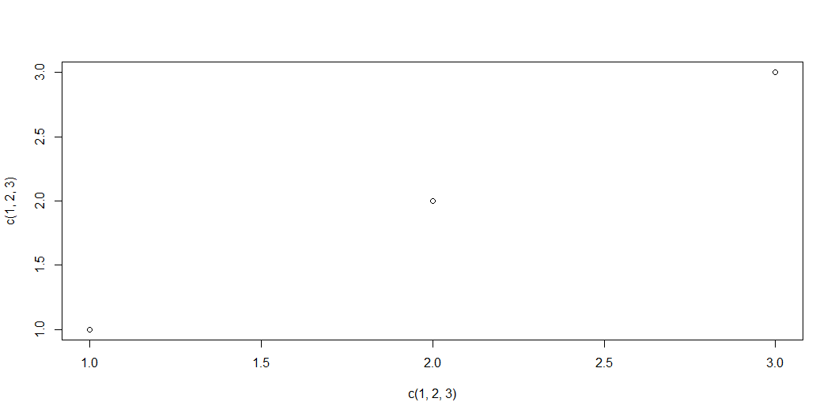
Look at this graph!

